Slide 1

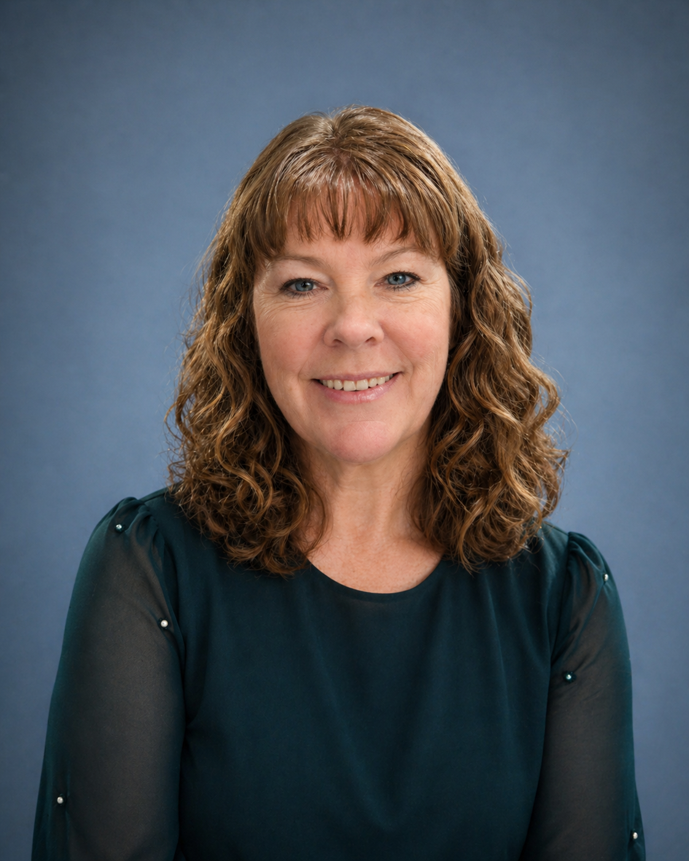
Compensatory Strategies After Brain Injury
Guest Speaker: Sarah Grant

Slide 2
Agenda
What are compensatory strategies?
Life immediately after brain injury
Caregiver compensatory strategies
Survivor challenges after brain injury
Survivor compensatory strategies
Common pitfalls and overstimulation triggers
Building solutions together
Recovery and lifelong adaptation
Questions and discussion

Slide 3
What Are Compensatory Strategies?
Tools that reduce overload
Systems that improve function
Supports for memory, fatigue, and organization
Ways to improve quality of life
Examples:
Calendars
Alarms
Routines
Notes
Rest breaks
Meal prep

Slide 4
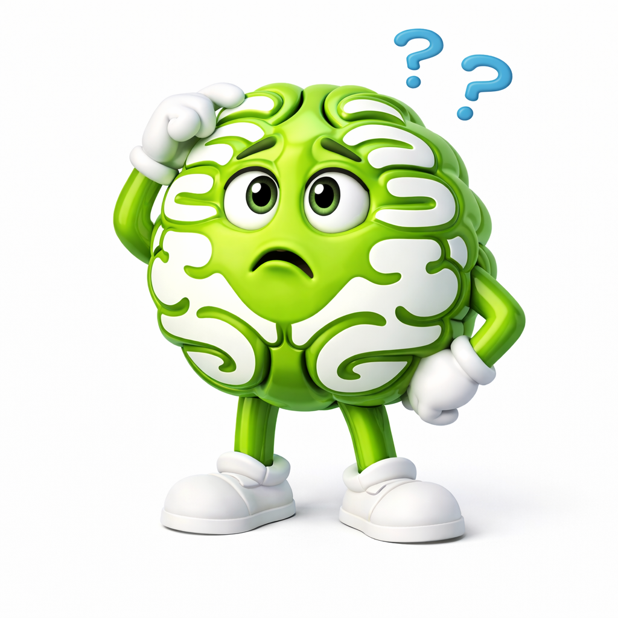
Life After the Accident
Missed medications
Lost paperwork
Too many appointments
Repeating the story constantly
Exhaustion
Overload
Fear of forgetting something important
Everything felt chaotic.

Slide 5
Caregiver Strategies
Shared calendars
Written notes
Medication alarms
Provider folders
Appointment summaries
Routines and schedules
Sleep protection
Breaking tasks into smaller steps

Slide 6
When Things Didn’t Go Well
Returning calls months late
Forgetting to pay bills
Missing details
Overdoing activities
Crashing after stimulation
Trouble processing information
Invisible struggles affected daily life.

Slide 7
Survivor Strategies
Pacing
Rest before overload
Simplified routines
Written instructions
Reduced multitasking
Quiet breaks
Energy management
Predictability

Slide 8
Pitfalls
Holidays
Travel
Family gatherings
Conferences
Intensive brain days
Poor sleep
Overstimulation
Busy schedules

Slide 9

Building Solutions Together
Shared systems
Defined processes
Scheduled breaks
Meal prep
Quiet recovery time
Communication
Humor
Flexibility

Slide 10

Recovery & Lifelong Strategies
Pacing
Predictability
Monitoring overload
Prioritizing sleep
Structured routines
Recognizing warning signs
Simplifying life
Adapting together

Slide 11
Questions
What strategies help you?
What challenges remain difficult?
What would you share with others?

Slide 12
Closing Thoughts….
Compensatory strategies are not failure.
They are tools that help people:
adapt
participate
function
heal
build meaningful lives
Just keep moving forward.

